Slide 1

Music Generation using Restricted-Boltzmann-Machines and Tensorflow
Research Project by
Manasa B S
Chetan M Jadhav
Gaurav Dinesh Sonkar
Notes:
To change the image on this slide, select the picture and delete it. Then click the Pictures icon in the placeholder to insert your own image.

Slide 2
Background Research
Deep learning for music generation is currently a hot research topic.
Music generation already uses many AI applications for music composition, streaming and music monetization
We in this research project are trying to further the outcome of music composition by employing Neural network.
Neural network is an learning algorithm and we are using RBM.
The active leading music generation is project by Google called Magenta.

Slide 3
Problem Statement
The music industry has adopted demand generation concept and there is constant demand for new musical content to be used in different areas.
Objective: To generate musical content using deep learning. Audio files undergo change of format from MIDI to array of numbers then the output back to MIDI files. Then later merged to form a song of trained genre.

Slide 4
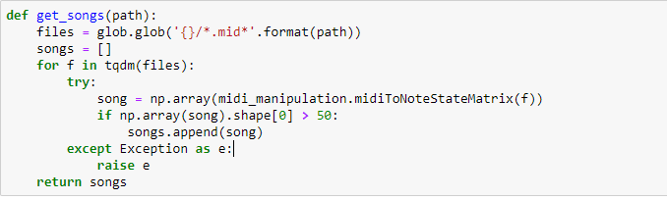
Dataset
The data set was obtained from
https://mega.nz/#!Elg1TA7T!MXEZPzq9s9YObiUcMCoNQJmCbawZqzAkHzY4Ym6Gs_Q
code snippet converts the MIDI files to array.

Slide 5
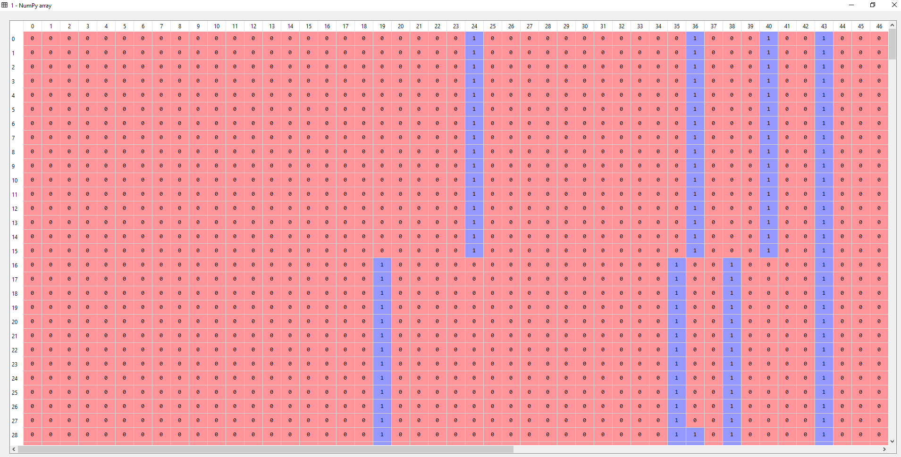
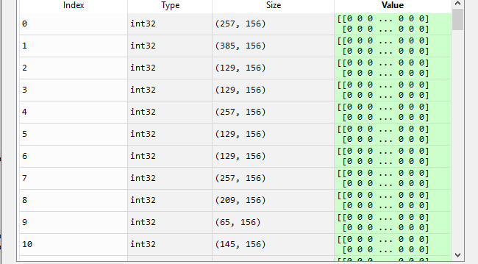
Dataset
sample of how the converted data looks like

Slide 6
Approach
Pre Processing
Convert MIDI to array
Fit Model
Train models using RBM(RNN)
Post Processing
Reformat data to MIDI files
Merge MIDI Files snippet to form a longer and final music file.
Epochs = 200
Batch Size = 50, ETC

Slide 7
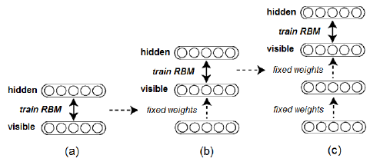
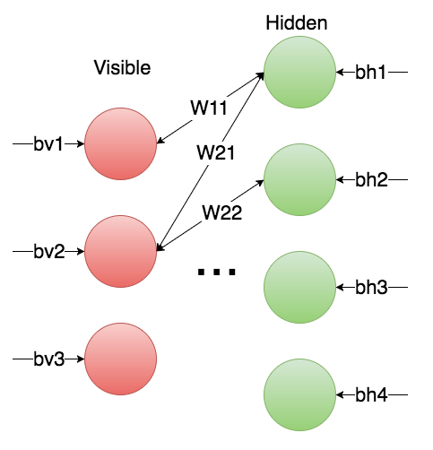
Approach:
This project involves the generation of music by training the Restricted Boltzmann Machine (RBM) model using TensorFlow on a set of homogeneous instrumental music to produce new music.

Slide 8
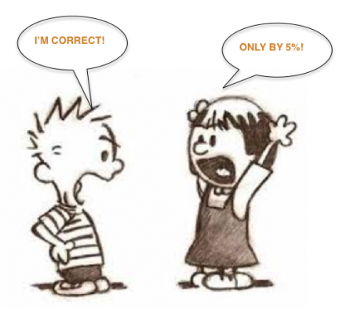
Evaluation
One of the major challenge encountered in Music generation is analysis how good or bad the generated music sounds. This usually is estimate of how our model could incorporate the general music theory into the generated the music.
To evaluate the music, we thought of both Qualitative and Quantitative.

Slide 9


Qualitative analysis *Conduct a listening test on small group of 10 to evaluate difference the model output and human composed music

Slide 10

Quantitative Analysis
We have to come up with a metric to measure how well your model outputs fit the distribution of a held-out evaluation set. We could also use music theory to analyze whether the music from model makes sense/does what is expected.

Slide 11
Conclusion: The deep learning MIDI music generation showed promising results by integrating key features of Pop music. The model suffers in tonality due to limited training set and that the end result has a piano roll.
Future Scope:
1.Work towards developing metrices that evaluates the generated output based on music theory for specific genre.
2. If the project can be established to full potential we could use this for music composition.

